Slide 1




Mode
Switching
PressrueControl
Soft
Actuator
SMC
NDOB

Slide 2
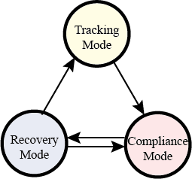
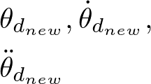
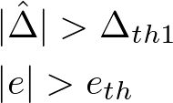


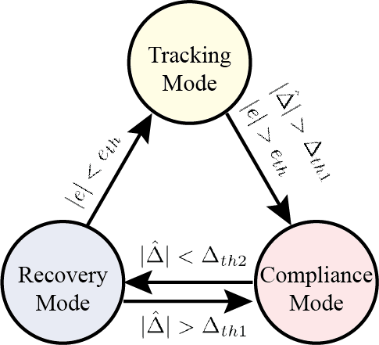

Mode Switching
Pressure Control
Soft
Actuator
SMC
NDOB

Slide 3



Torque/Force Controller
Pressure Controller
2-Segment
Soft Arm
ASMC
$$\hat{d}$$
Inner Loop
INDOB

Slide 4

INASMC
Inner loop
ASMC
Soft Arm
$$\hat{d}$$
INDOB
Torque/Force Controller
Pressure Controller
Inner Loop

